Slide 1


Tittle: Arduino uno distance measurement
presented by Muhammad ‘atiqulhakim bin mohd ramli

Slide 2
Personal detail
NAME: MUHAMMAD ‘ATIQULHAKIM BIN MOHD RAMLI
STUDENT ID: DE96562
SUBJECT: INTRODUCTION TO MICROCONTOLLER
SUBJECT CODE: EEED253
SEMESTER: FINAL YEAR SEMESTER 1 20/21
UNIVERSITY: UNIVERSITI TENAGA NASIONAL (UNITEN) PUTRAJAYA CAMPUS

Slide 3
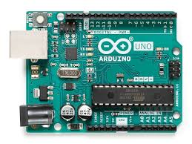
INTRODUCTION
In each sector, small requirements are essential for the development of major measures, including occurring new normal for today.
Using the Arduino UNO board, I can construct a measuring system and use a specific display unit to measure the distance, especially the centimeter (cm) and the meter (m).
Available: https://images.app.goo.gl/yaXhLKgkRqFABkns6

Slide 4
Material: Arduino uno
To write the programming code and upload into physical board.

Slide 5
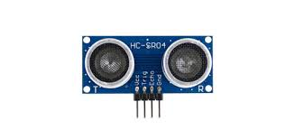
Material: Ultrasonic distance sensor
Measure the distance from a target or obstacle

Slide 6
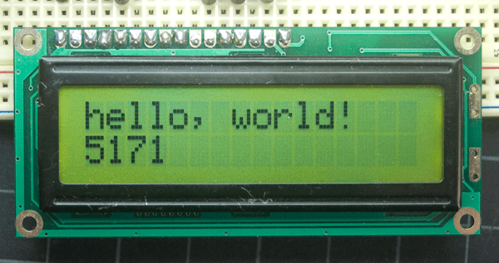
Material: Liquid Crystal Display (LCD) 16x2 Green Version
To display the output from ultrasonic sensor.

Slide 7
Program flowchart

Slide 8
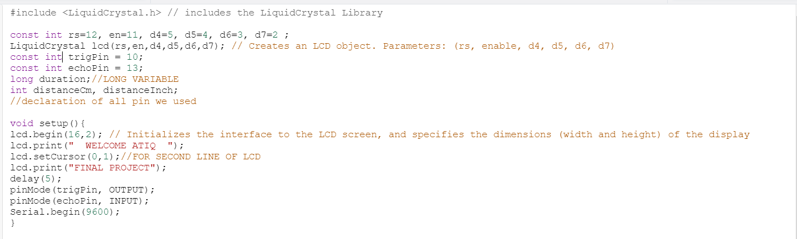
Main coding

Slide 9


Simulation in thinkercad
https://www.tinkercad.com/things/dIGo5vfI5aP-final-project/editel?sharecode=VfwLz9HYxN6uVCfxVmfMCz0kZwo0WGXSDUclS3ieP6U

Slide 10
discussion
ADVANTAGES | WEAKNESS
It is easy to carry anywhere | Cannot exposed or underwater use.
2) Suitable for all sector | Limitations detection range( 2cm±400cm).
3) Can be used in dark environments | Cannot work in vacuum.

Slide 11

Thank you

